Slide 1


THE BETTER POLICY PROJECT
AI-POWERED LEARNING
CENTRAL BANK OF ARMENIA · WORKING PAPER 2022/07
Getting FIT with
Imperfect Policy Credibility
A small-open-economy model with endogenous credibility — calibrated to Armenia
Asya Kostanyan · Anahit Matinyan · Angela Papikyan with the FPAS Mark II team, Central Bank of Armenia
01
The Model
From the closed-economy ENDOCRED to a small open economy
02
Credibility & Nonlinearities
Why trust, convexity, and a loss function change the policy answer
03
The Case of Armenia
Historical narrative, the Q1-2022 scenarios, and the folly analysis
Chulalongkorn University · Bangkok, Thailand · Day 2 · June 16, 2026

Slide 2




OPEN ENDOCRED · CBA WORKING PAPER 2022/07
OVERVIEW
What This Paper Develops
A nonlinear workhorse QPM for flexible-inflation-targeting small open economies
Open ENDOCRED model
Credibility × country risk
A small-open-economy extension of the closed-economy ENDOCRED workhorse (Kostanyan et al. 2022b), in the spirit of Argov et al. (2007).
Endogenous policy credibility interacts with the country-risk premium and the real exchange rate — the new external channels.
A core QPM for FPAS Mark II
Calibrated to Armenia
Built to support monetary policy as a risk-management exercise under deep uncertainty and crucial nonlinearities.
The first calibration, with empirical estimates of credibility and a real-world Q1-2022 application.
www.thebetterpolicyproject.org
www.ai-powered-learning.org
2

Slide 3



OPEN ENDOCRED · CBA WORKING PAPER 2022/07
WHY THIS MODEL
Three Departures from the Standard QPM
What FPAS Mark I models leave out — and this model puts back in
01
02
03
Endogenous policy credibility
Crucial nonlinearities
Explicit loss function
Credibility is a stock: lost quickly when inflation is high, persistent, and expectations de-anchor — but regained only slowly and nonlinearly.
A convex, inflation-expectations-augmented Phillips curve and a nonlinear credibility-generation process.
Optimal policy minimizes a quadratic loss over the full horizon, replacing the conventional interest-rate reaction function.
www.thebetterpolicyproject.org
www.ai-powered-learning.org
3

Slide 4
OPEN ENDOCRED · CBA WORKING PAPER 2022/07
FROM CLOSED TO OPEN
Extending ENDOCRED for a Small Open Economy
Same philosophy as the closed-economy model — with new external channels
 | Closed ENDOCRED (US) | Open ENDOCRED (Armenia)
Benchmark application | United States | Armenia
Exchange rate | — (closed) | Real exchange rate; UIP with risk premium
Output-gap drivers | Rate gap, term premium | + Real exchange-rate gap, world output gap
Inflation / Phillips | Convex in the output gap | + Direct & indirect FX pass-through
Credibility channel | Expectations only | + Dollarization / capital flight via the premium
Max excess demand ŷmax | 5 | 6 (imports relax capacity)
Source | Kostanyan et al. (2022b) | This paper · Argov et al. (2007)
www.thebetterpolicyproject.org
www.ai-powered-learning.org
4

Slide 5

ENDOGENOUS CREDIBILITY
ENDOGENOUS CREDIBILITY
How Much Agents Trust the Bank?
THE BIG IDEA
Agents form expectations as a weighted mix of the target and observed past inflation. The weight — credibility — evolves with the bank's track record, so credibility itself becomes a state variable.
HIGH CREDIBILITY
LOW CREDIBILITY
Expectations anchored
Expectations drifting
High weight on the target
Deviations read as transitory
Policy can act gradually
Shocks absorbed by the system
More weight on observed past inflation
Deviations persistent & self-reinforcing
Policy must act forcefully to regain control
The cost of late action rises sharply
www.thebetterpolicyproject.org
www.ai-powered-learning.org
5

Slide 6

THE CREDIBILITY STOCK
THE CREDIBILITY STOCK
Credibility: Slow to Earn, Quick to Lose
A bounded stock, updated from the bank's inflation track record
Illustrative credibility path
Bounded weight
C ∈ [0,1] sets how forward- vs backward-looking expectations are.
Bayesian-style signal
S compares outcomes against a credible-target regime vs a high-inflation regime.
Asymmetric & nonlinear
Credibility erodes fast; re-anchoring is gradual.
Armenia
≈ 0.9 before the shock, falling toward ~0.6 under persistent inflation.
www.thebetterpolicyproject.org
www.ai-powered-learning.org
6

Slide 7
INFLATION EXPECTATIONS
INFLATION EXPECTATIONS
Forward- and Backward-Looking Expectations
More backward-looking than a standard DSGE model — by design
Cₜ weight on the model-consistent forward forecast (credibility).
(1 − Cₜ) weight on last year's observed inflation — the backward-looking pull.
πᵇₜ bias term: expectations ratchet up as credibility falls.
(1 − Cₜ)·εᶻ⁺ asymmetric pass-through — depreciation shocks bite in low-credibility states; appreciations are largely ignored.
www.thebetterpolicyproject.org
www.ai-powered-learning.org
7

Slide 8
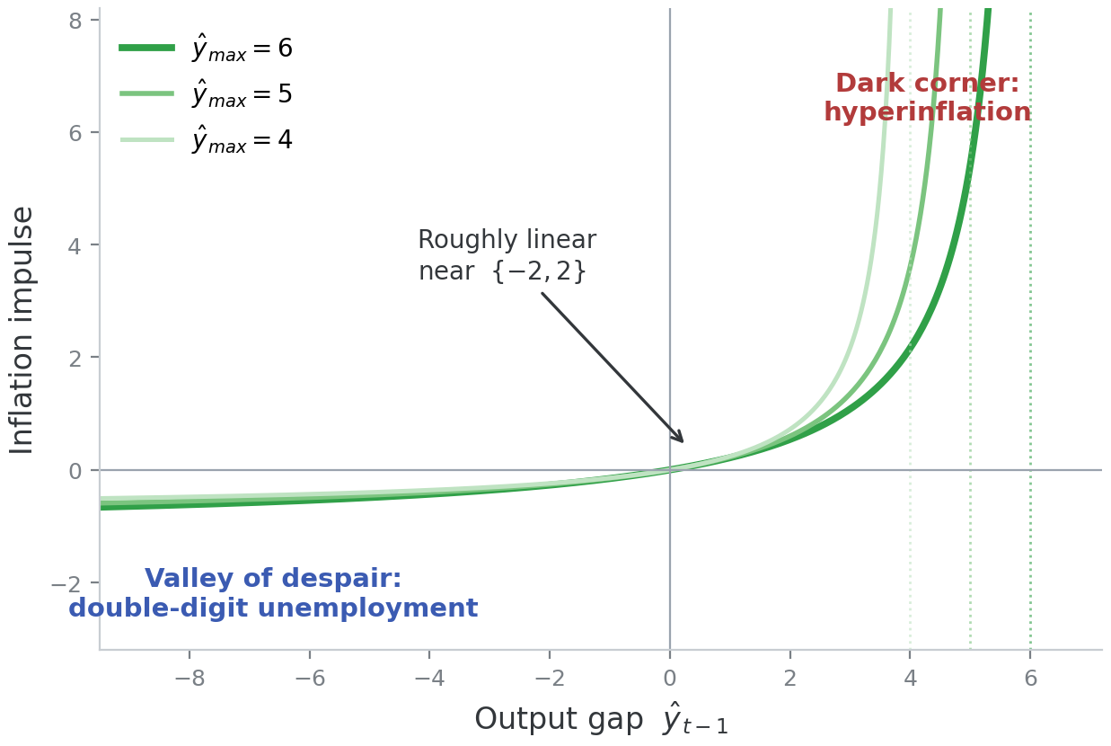
NONLINEARITY
NONLINEARITY
The Convex Phillips Curve
Where linear approximations hide the dark corners
Convexity
Near ŷmax extra demand is increasingly inflationary (a vertical asymptote); in deep excess supply the curve flattens — downward wage rigidity.
Dark corners
Linear models miss both tails: runaway inflation on one side, a double-digit-unemployment valley on the other.
ŷmax = 6 (vs 5 closed)
An open economy can import to relax capacity constraints.
www.thebetterpolicyproject.org
www.ai-powered-learning.org
8

Slide 9
OUTPUT GAP
OUTPUT GAP
Output Gap: Now with External Demand
Two new terms open the closed-economy output gap
β₁ŷ₋₁ , β₂ŷ₊₁ inertia vs forward-looking behaviour — set by how rigid the economy is.
− β₃ r̂₋₁ the real interest-rate gap: the demand channel of policy.
+ β₄ ẑ₋₁ the real exchange-rate gap: competitiveness (ẑ > 0 = depreciation).
+ β₅ ŷ ʷ the world output gap: external demand and openness.
β₁ 0.50–0.70 β₂ 0.10–0.25 β₃ 0.15–0.40 β₄ 0.00–0.20 β₅ 0.12–0.24
www.thebetterpolicyproject.org
www.ai-powered-learning.org
9

Slide 10

EXCHANGE RATE
EXCHANGE RATE
Real Interest Parity with a Country-Risk Premium
Real parity The domestic real rate equals the US real rate, plus the risk premium, plus the expected change in the real exchange rate.
A credibility channel As credibility falls, the bias term π4ᵇ rises → dollarization and capital flight → nominal depreciation (positive sign).
Equilibrium premium ψ̄** follows a random walk; current-account and net-foreign-liability stock-flow dynamics are left to satellite models.
www.thebetterpolicyproject.org
www.ai-powered-learning.org
10

Slide 11

BIAS & OBJECTIVE
BIAS & OBJECTIVE
The Credibility Bias and the Policy Objective
Bias term in inflation expectations
Monetary-policy loss function
Bias (κ = 0.10)
Loss (ρ = 0.95, ω₁ = 1)
Why a loss, not a rule?
Blends low- and high-credibility expectation regimes — a source of stagflationary shocks in dollarized economies.
Penalizes squared inflation-gap, output gap, and one-quarter rate changes.
Robust to structural change across scenarios, and it yields a full-horizon total-loss metric for risk assessment.
www.thebetterpolicyproject.org
www.ai-powered-learning.org
11

Slide 12
CALIBRATION
CALIBRATION
Calibration at a Glance
Ranges and central values — critical judgment is needed for each economy
Parameter | Role | Range (central)
λ₁ | Forward weight in the Phillips curve | 0.55 – 0.80
λ₂ | Output-gap slope (convex term) | 0.15 – 0.40 (0.18)
ŷmax | Maximum excess demand | 5 – 7 (6)
β₁, β₂ (π) | Direct / indirect FX pass-through | 0.05 – 0.25 (0.20)
κ | Expectations bias | 0.00 – 0.30 (0.10)
β₁ … β₅ (ŷ) | Output-gap weights | 0.50–0.70 / 0.10–0.25 / 0.15–0.40 / 0.00–0.20 / 0.12–0.24
β₂, β₃ (ψ) | Credibility bias in the risk premium | 0.66 / 2.30
β₄ (ζ) | Forward-looking weight in the FX equation | 0.50 – 1.00 (0.70)
ρ, ω₁ / ω₂ / ω₃ | Loss discount and weights | 0.95, 1 / 0.5–1.5 / 0.4–0.6
www.thebetterpolicyproject.org
www.ai-powered-learning.org
12

Slide 13
THE CASE OF ARMENIA
THE CASE OF ARMENIA
Two Decades in Four Acts
Inflation targeting since 2006 — and the making (and testing) of credibility
01
02
03
04
2006–2009
2009–2014
2014–2020
2020–2022
Double-digit growth
Slow growth, high risk premia
Disinflation
Post-war, post-pandemic
Capital inflows, ~50% appreciation, a real-estate boom — demand-driven inflation despite a strong dram.
GFC sudden stop, debt-sustainability doubts; sticky-price inflation kept expectations elevated.
Ruble-shock spillover, then +12pp of tightening and a disinflation that rebuilt credibility and cut dollarization.
Early proactive hikes (Dec-2020); by late 2022 the policy rate reached 10.5% amid inflows and overheating.
www.thebetterpolicyproject.org
www.ai-powered-learning.org
13

Slide 14
SCENARIO ANALYSIS · Q1 2022
SCENARIO ANALYSIS · Q1 2022
Two Risk-Management Scenarios
Case A = hawkish (rate above market) Case B = dovish (rate below market) Case X = tail risks / dark corners
CASE A
CASE B
Persistent inflation, demand pressures
A mixed bag
War creates a preference shock for Armenian goods, plus Russian migration and tourism
Bottlenecks steepen the Phillips curve; the dram appreciates
Policy must move fast → rate peaks ≈ 15%, credibility falls ~0.9 → ~0.6
Excess capacity absorbs demand; bottlenecks hit later
Lower remittances soften demand; a risk-premium shock brings some depreciation
Rate still rises, but less — inflation returns with smaller hikes
www.thebetterpolicyproject.org
www.ai-powered-learning.org
14

Slide 15
FOLLY ANALYSIS
FOLLY ANALYSIS
What If You Get the Framework Wrong?
Re-running the Case A scenario under flawed assumptions
B.1
B.2
B.3
Delayed response
Linear + perfect credibility
Linear + delayed
Holding rates for two quarters forces a higher peak (≈ 18% vs 15%) and a deeper cumulative output loss (≈ −6% vs −3%).
A DSGE-like linear model peaks at only ≈ 12% — systematically underestimating the response actually needed.
The two errors compound: the bank never sees the imperative to act — echoing the 1970s Great Inflation.
Assuming perfect credibility and linearity tricks policymakers into “too little, too late.”
www.thebetterpolicyproject.org
www.ai-powered-learning.org
15

Slide 16
CBA INFLATION REPORT 2022/2
THE OFFICIAL RECORD · CBA INFLATION REPORT 2022/2
What Actually Happened: Q1–Q2 2022
The realized episode behind the model's Case of Armenia
9.25%
9.0%
4.9%
Refinancing rate, held in June 2022 — after +3.75pp over the prior year
12-month inflation, May 2022 (core 8.4%) — above the 4% target
2022 growth, revised up from 1.6% in the previous program
+8.6%
+8.85%
H2 2023
Q1 2022 GDP — services- and demand-led
Dram vs USD, Mar–May (real effective +4.88%)
Projected return toward the 4% inflation target
Source: Central Bank of Armenia, Inflation Report 2022/2 (Monetary Policy Program Q2 2022; Status Report Q1 2022).
www.thebetterpolicyproject.org
www.ai-powered-learning.org
16

Slide 17
CBA INFLATION REPORT 2022/2
WHAT DROVE IT
The Inflow Shock, in the Data
A demand and capital inflow — predominantly from Russia — that appreciated the dram
Visitor mix shifted
Russian citizens were 43.7% of Q1 tourists, up from 34.9% a year earlier.
WHAT IT MEANT FOR INFLATION
≈ 1.2 pp
Services surged
Accommodation, catering, apartment rents and financial services rose sharply.
of 12-month inflation offset by the appreciation (Apr–May 2022)
Capital and labour arrived
New foreign-founded firms — mainly IT — and a jump in non-resident bank accounts.
4.9% vs 3.6%
The dram as shock absorber
2022 growth with vs without the inflows (Bank's counterfactual) — without them, lower short-run inflation and less appreciation.
Under a floating regime the currency softens the shock (Friedman, 1953).
www.thebetterpolicyproject.org
www.ai-powered-learning.org
17

Slide 18
CBA INFLATION REPORT 2022/2
POLICY RESPONSE
The Bank's Read — and the Decision
THE DILEMMA · INFLATION REPORT, BOX 3
FX absorbs the shock
THE JUNE 2022 DECISION
Under floating rates the real exchange rate appreciates either way — the currency does much of the adjustment.
Rate held at 9.25% — prior tightening judged sufficient
Inflation seen returning toward 4% from H2 2023
Risks to the outlook assessed as balanced
Risk premium rose, stabilized, then rose again with global tightening — long-run level unchanged
Policy manages the residual
Appreciation eases imported inflation; monetary policy handles the residual de-anchoring risk.
Fixing shifts the burden
Intervening to hold the rate pushes adjustment onto domestic inflation and the policy rate.
Sectoral risk ≠ monetary tool
“Dutch-disease” risks in services are best met with targeted fiscal policy.
Case A, realized: a demand-driven appreciation, a credibility-protecting hold, and the exchange rate doing much of the adjustment.
www.thebetterpolicyproject.org
www.ai-powered-learning.org
18

Slide 19
FPAS MARK II
FPAS MARK II · CONCLUSION
From Expert Forecaster to Risk Manager
KEY TAKEAWAYS
Credibility is endogenous
DISCUSSION QUESTIONS
Treating it as given underestimates the timing and size of the needed response.
What would scenario-based (A/B/X) communication change at your central bank?
How would you measure credibility in your economy — what data would you reach for?
Where would endogenous credibility most have changed a past policy call?
What governance is needed before such a model is decision-grade?
Nonlinearities matter
Convexity and the credibility process create real welfare costs that linear models hide.
The tool needs the framework
ENDOCRED adds value only inside an FPAS Mark II, scenario-based, transparent-communication approach.
The goal
Avoid the “dark corners where danger lurks.”
www.thebetterpolicyproject.org
www.ai-powered-learning.org
19

